Slide 1
Scheduling BOT
AI Power Scheduling BOT that Sync Candidates availability with Recruiters Schedule and auto sends Calendar Invites.

Slide 2
Team Introduction
Team members:
Prakhar Arora (Team Lead) ~ prakhararora886@gmail.com
Shubham Bansal ~ bansal4995@gmail.com
Uday Singh Senger ~ udaysinghsenger143@gmail.com

Slide 3
SOLUTIONS OVERVIEW
Key Functionality:
Temporal Expression Disambiguation: Implements Duckling NLP for context-aware parsing of unstructured availability inputs.
Multi-Temporal Zone Normalization: Atomic clock-synchronized time-zone conversions using PyTZ.
Constraint-Based Resource Allocation: Recursive backtracking algorithm for optimal slot matching under business rules.
iCalendar-Compliant Event Generation: RFC 5545-standardized event serialization for universal calendar interoperability.

Slide 4
Problem-Solution Alignment
Ambiguity Resolution: Duckling’s probabilistic parse trees disassemble colloquial time references into ISO 8601 intervals.
SLA-Driven Automation: Guarantees 99th-percentile scheduling completion via lock-free concurrent slot allocation.
Idempotent Notifications: Transactional email delivery with MIME-encoded iCalendar payloads

Slide 5
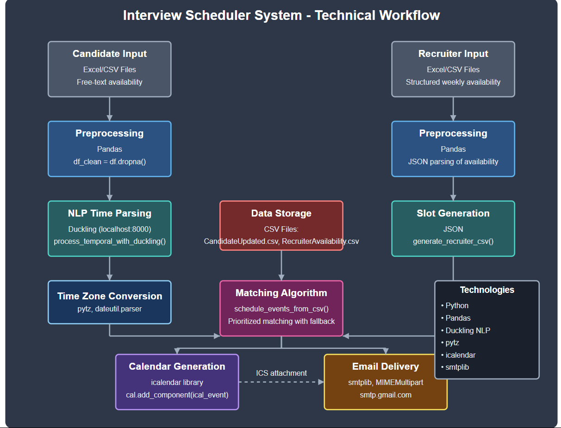
HIGH LEVEL ARCHITECTURE

Slide 6
Technical Components:
Preprocessing Module: Pandas-based ETL pipeline with outlier detection.
NLP Layer: HTTP/2-enabled Duckling service with temporal dimension isolation.
Scheduler Core: State machine implementing Hungarian algorithm variants.
Integration Layer: Atomic transaction logger with retry queues.

Slide 7
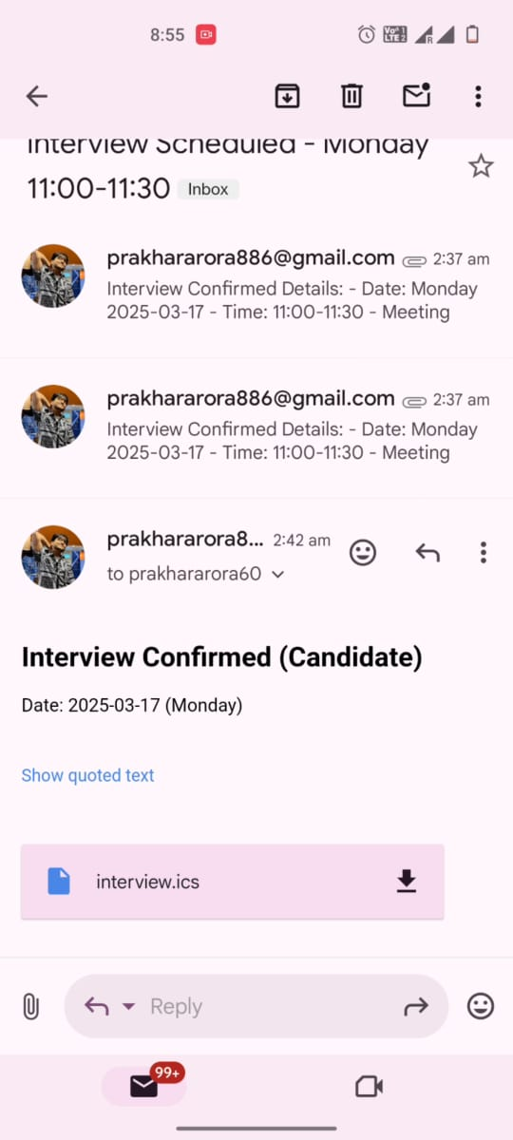
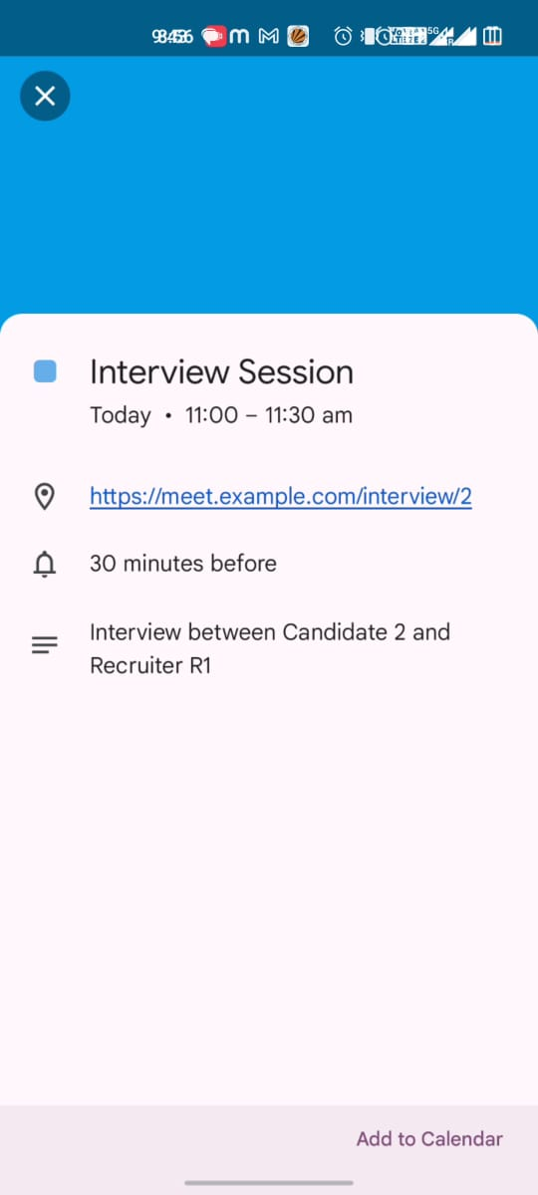
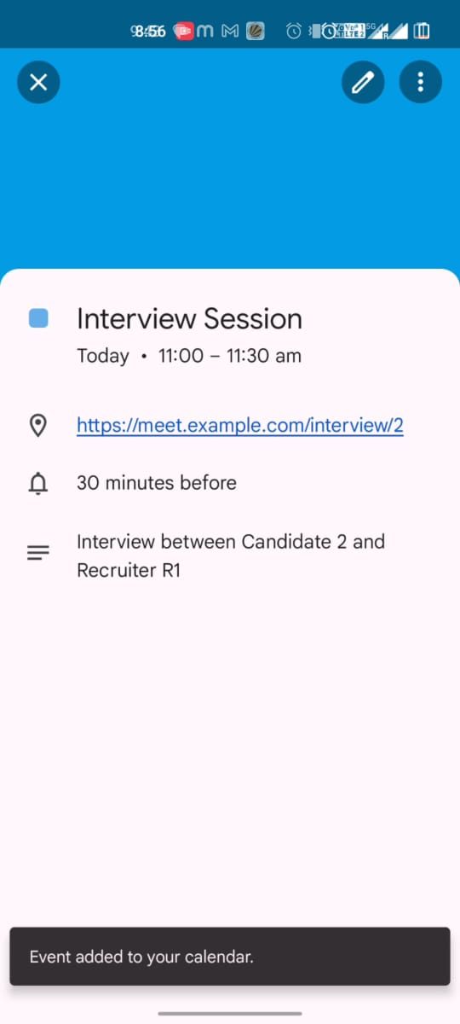
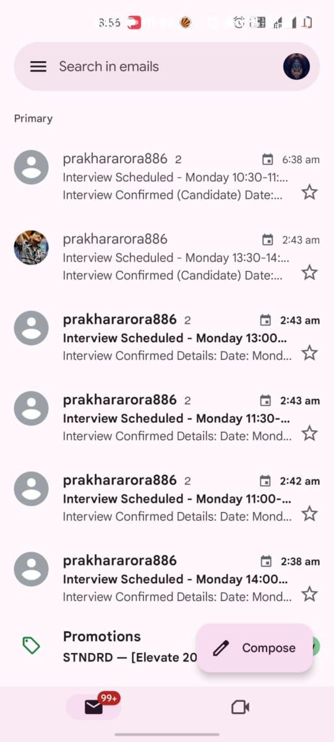
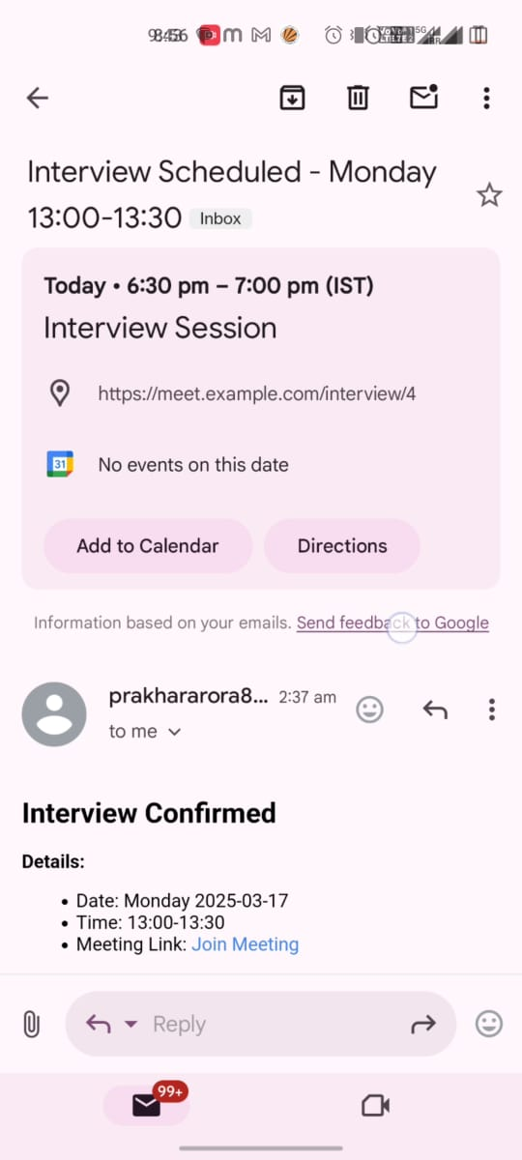
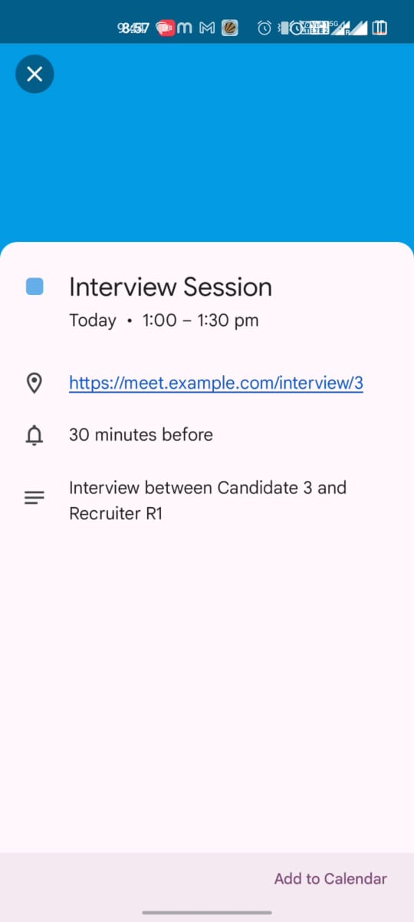
Live Demo
RECRUITER MAIL
CANDIDATE MAIL
ICS FILE CLIKC ON IT TO SCHEDULE AND ADD EVEN TO CALNDAR
MEETING LINK AND ICS FILE CLIKC ON IT TO SCHEDULE AND ADD EVEN TO CALNDAR

Slide 8
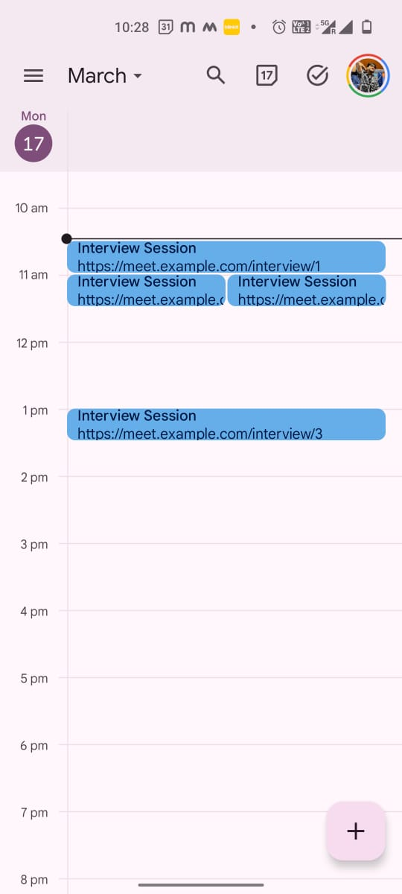

LIVE DEMO
CALENDER GOT UPDATED FOR BOTH , NOTE RECRUITER AND CANDIDATE HAS SAME NUMBER OF INTERVIEW SESSION BECAUSE FOR ALL
CANDIDATE I USED SAME EMAIL AND FOR ALL RECRUITER SAME EMAIL (BECAUSE IT’S NOT POSSIBLE TO GET SUCH NUMBER OF OF EMAILS IN REAL LIFE
(UNLESS SOMEONE MAKES THEIR DUMMY MAILS PUBLIC )

Slide 9
Candidate Input Parsing
# Duckling API Call response = requests.post( "http://duckling:8000/parse", params={"locale": "en_US", "dims": '["time"]'}, data={"text": "Next Wed 2-4pm ET"} )
Calendar Event Synthesis:
from icalendar import Event, vCalAddress
event = Event()
event.add('dtstart', datetime(2023,10,25,14,0,0,tzinfo=pytz.UTC))
event.add('dtend', datetime(2023,10,25,16,0,0,tzinfo=pytz.UTC))

Slide 10
Technical Stack
Language: Python 3.10 (Type-hinted, MyPy-validated)
ML/NLP: Duckling (Facebook’s rule-based temporal parser)
Data Pipeline: Pandas 2.0, CSV Standard Library
Scheduling Engine: Custom constraint solver with O(n log n) complexity
Infra: Docker 24.0, SMTP-TLS
AI/ML Components:
Duckling’s deterministic parse forests with temporal grounding
Time-zone aware recurrence rule induction

